Slide 1
March 24
Updates Smupdates

Slide 2
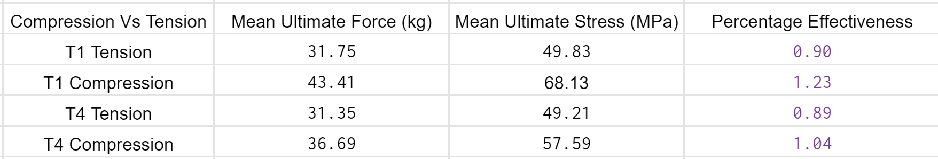
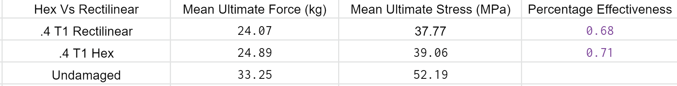
Data
Compression is stronger in both geometries compared to tension
Stronger than undamaged
T1 with larger repair is stronger than T4
Hex and Rectilinear very similar
Does not seem that infill pattern affects ultimate stress

Slide 3
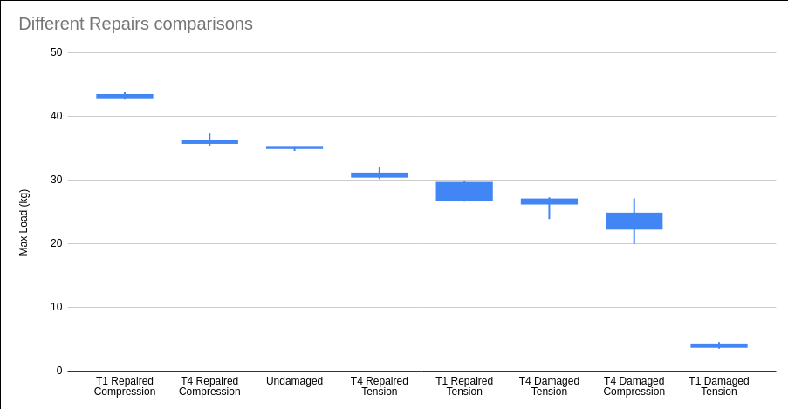
All Max Load data so far

Slide 4
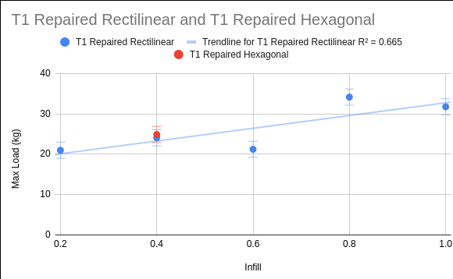
T1 Rect vs. Hex infill

Slide 5
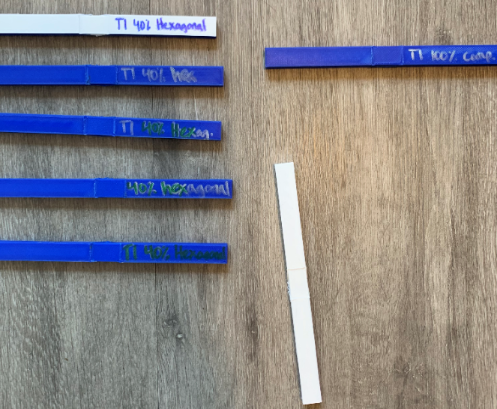
Prints
Completed:
6 of T1 40% hex,
12 of T1 80% hex
In progress:
T1 40% infill hexagonal

Slide 6
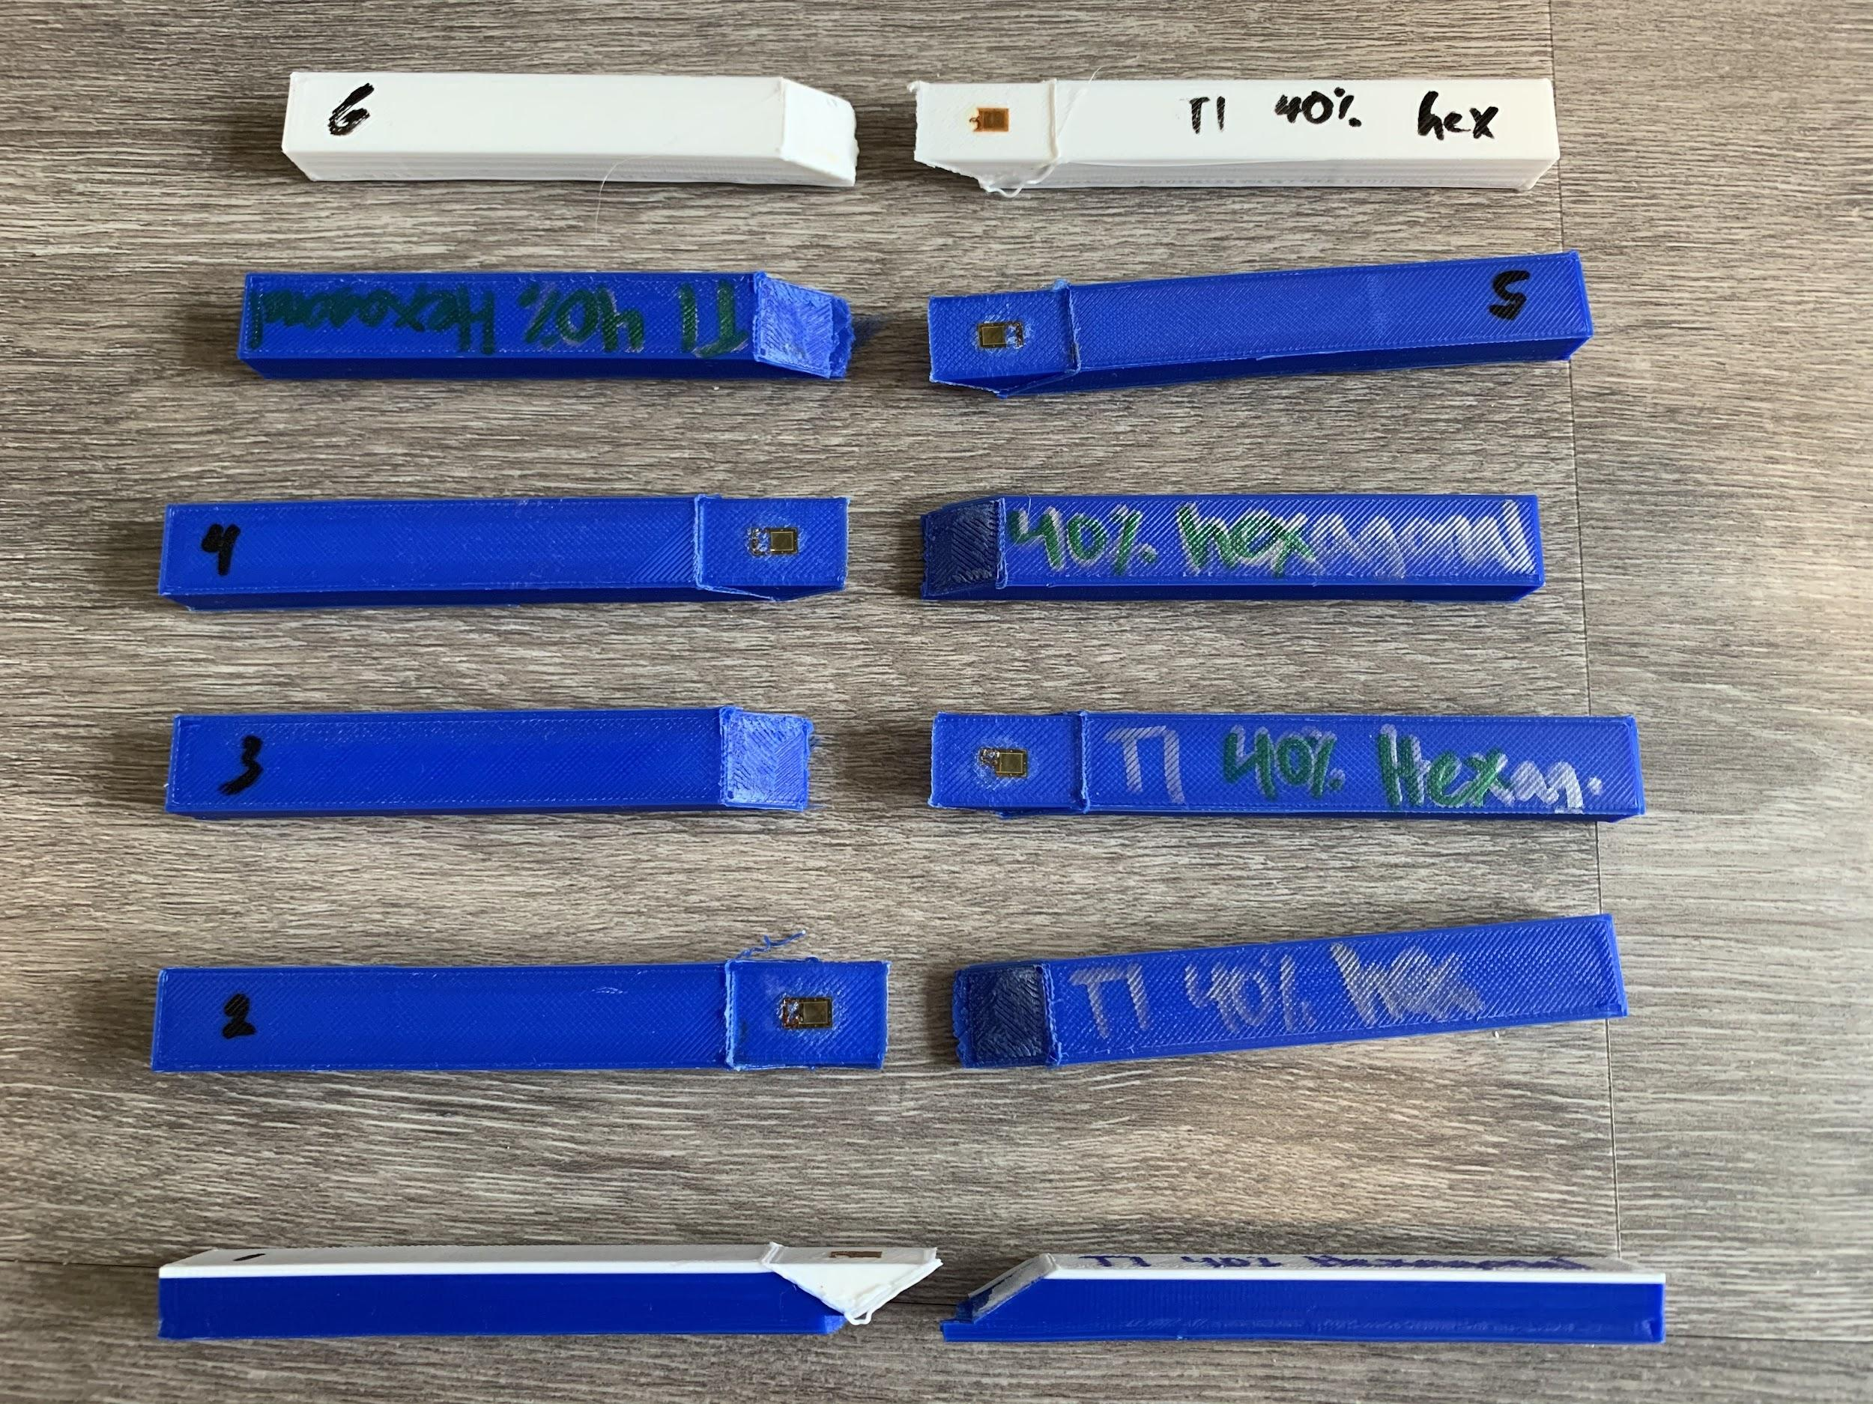
Current Test Progress
T1 40% hex complete
All 6 pieces broke the same way
Currently waiting on prints

Slide 7
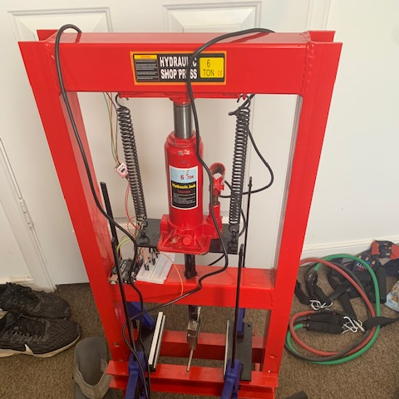

Press 2 is done

Slide 8
Undergraduate Research Day
Need to fill out form

